Slide 1
Analysis on supermarket sales for 3 cities in the Country of Myanmar
Done by: S.S.Jayanth

Slide 2
TABLE OF CONTENTS
Abstract
Introduction to the problem statement
Data interpretation and analysis
Conclusion
Actionable Insights and Summary

Slide 3
Abstract
This study focuses on the comprehensive analysis of supermarket sales within the country of Myanmar, specifically within three major cities: Mandalay, Naypyidaw, and Yangon. The analysis delves into sales data for both member and normal customer types, considering the demographic factors of gender – male and female. Employing Python programming and data visualisation tools, the study aims to uncover valuable insights into consumer purchasing behaviours and preferences. By examining sales patterns across different customer segments and cities, this research contributes to a better understanding of the dynamics driving supermarket sales in Myanmar. The findings from this analysis could potentially aid business strategies and decision-making processes for supermarket chains operating within these cities.

Slide 4
Introduction to the problem statement and data interpretation and analysis
1. What is the gross income distribution gender wise?
The gross income distribution across all the 3 Cities have been
plotted using python and power BI. In python, the plot is only gender
against gross income, while in power BI, we can see the plot
including per city as well. The plots indicate that the gender Female
have a slightly higher gross income compared to men.

Slide 5
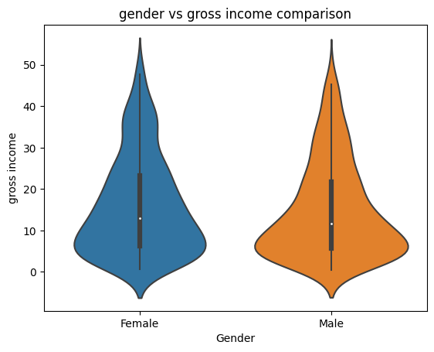
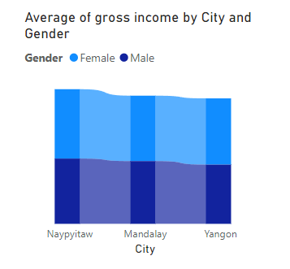

Slide 6
2. What is the total gross income distribution?
The total gross income distribution across all 3 cities has been
plotted using Python, which indicates that the data is actually
right skewed, i.e.; outliers in the right side of the data. When
logarithmic transformation was applied, we can observe that
the skewness moved to the left side of the data, however, the
data is closer to stability than the normally distributed data.

Slide 7
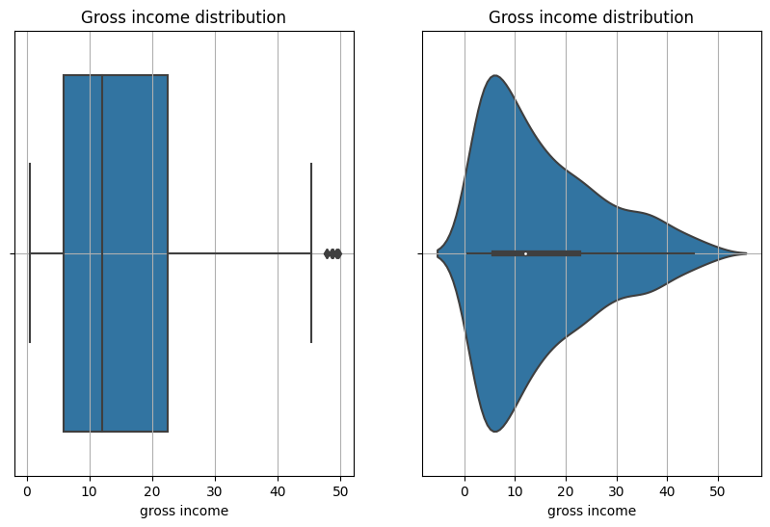
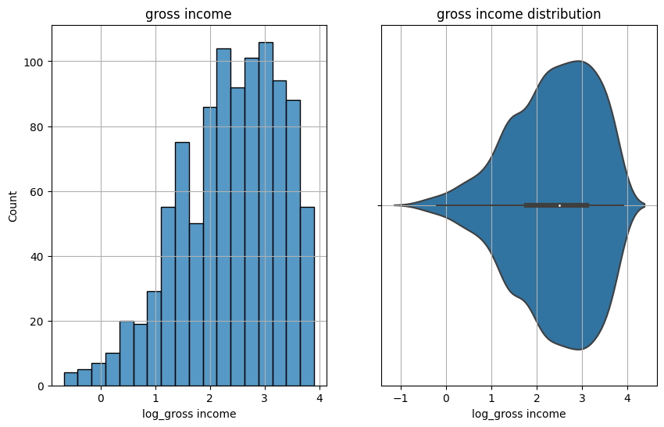
Normally distributed gross income plotNormally distributed gross income plotdistributed Normally distributed gross income plotgross income plot

Slide 8
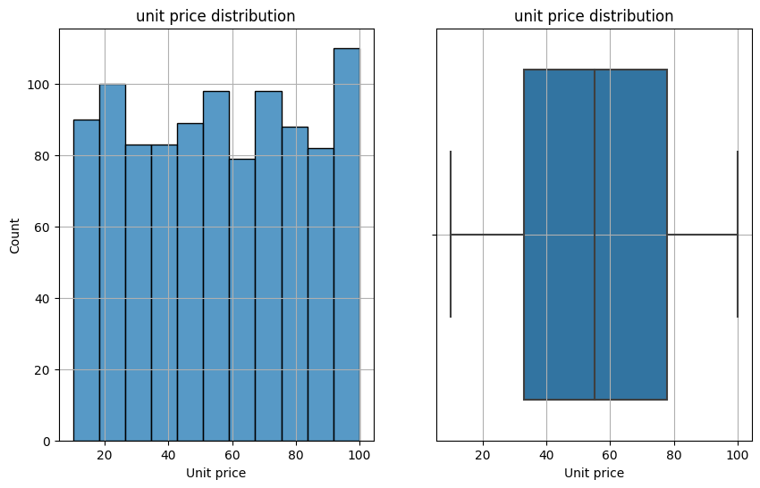
3. What is the total Unit price distribution?
The unit price distribution was plotted
using python, which states that the
data is normally distributed and there
are no outliers in the data, which implies
that the data stabilised.

Slide 9
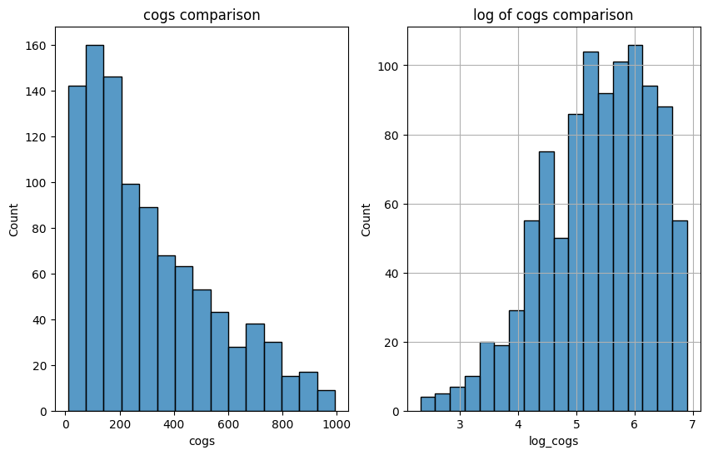
4. What is the cost of goods sold distribution?
The cost of goods sold is quite similar to
the gross income distribution plot wise,
however, the count if the plot varies, i.e.;
the parameters are significantly greater.

Slide 10
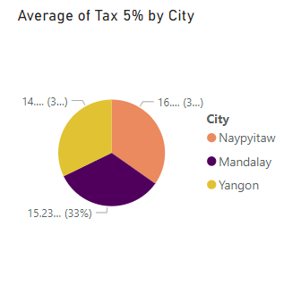
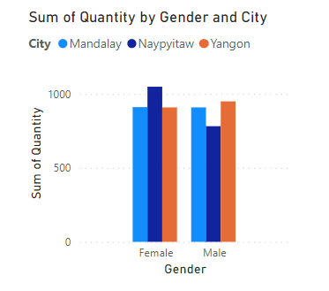
5. What are the other plots made for this dataset?
The other plots of the dataset are as below:

Slide 11
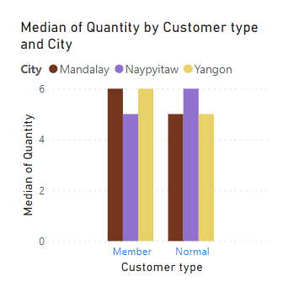
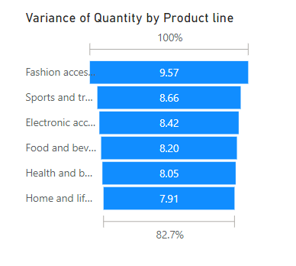
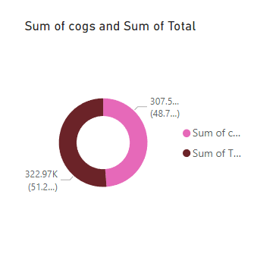

Slide 12
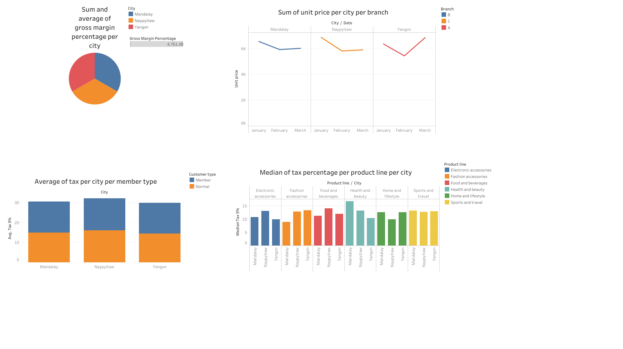

Slide 13
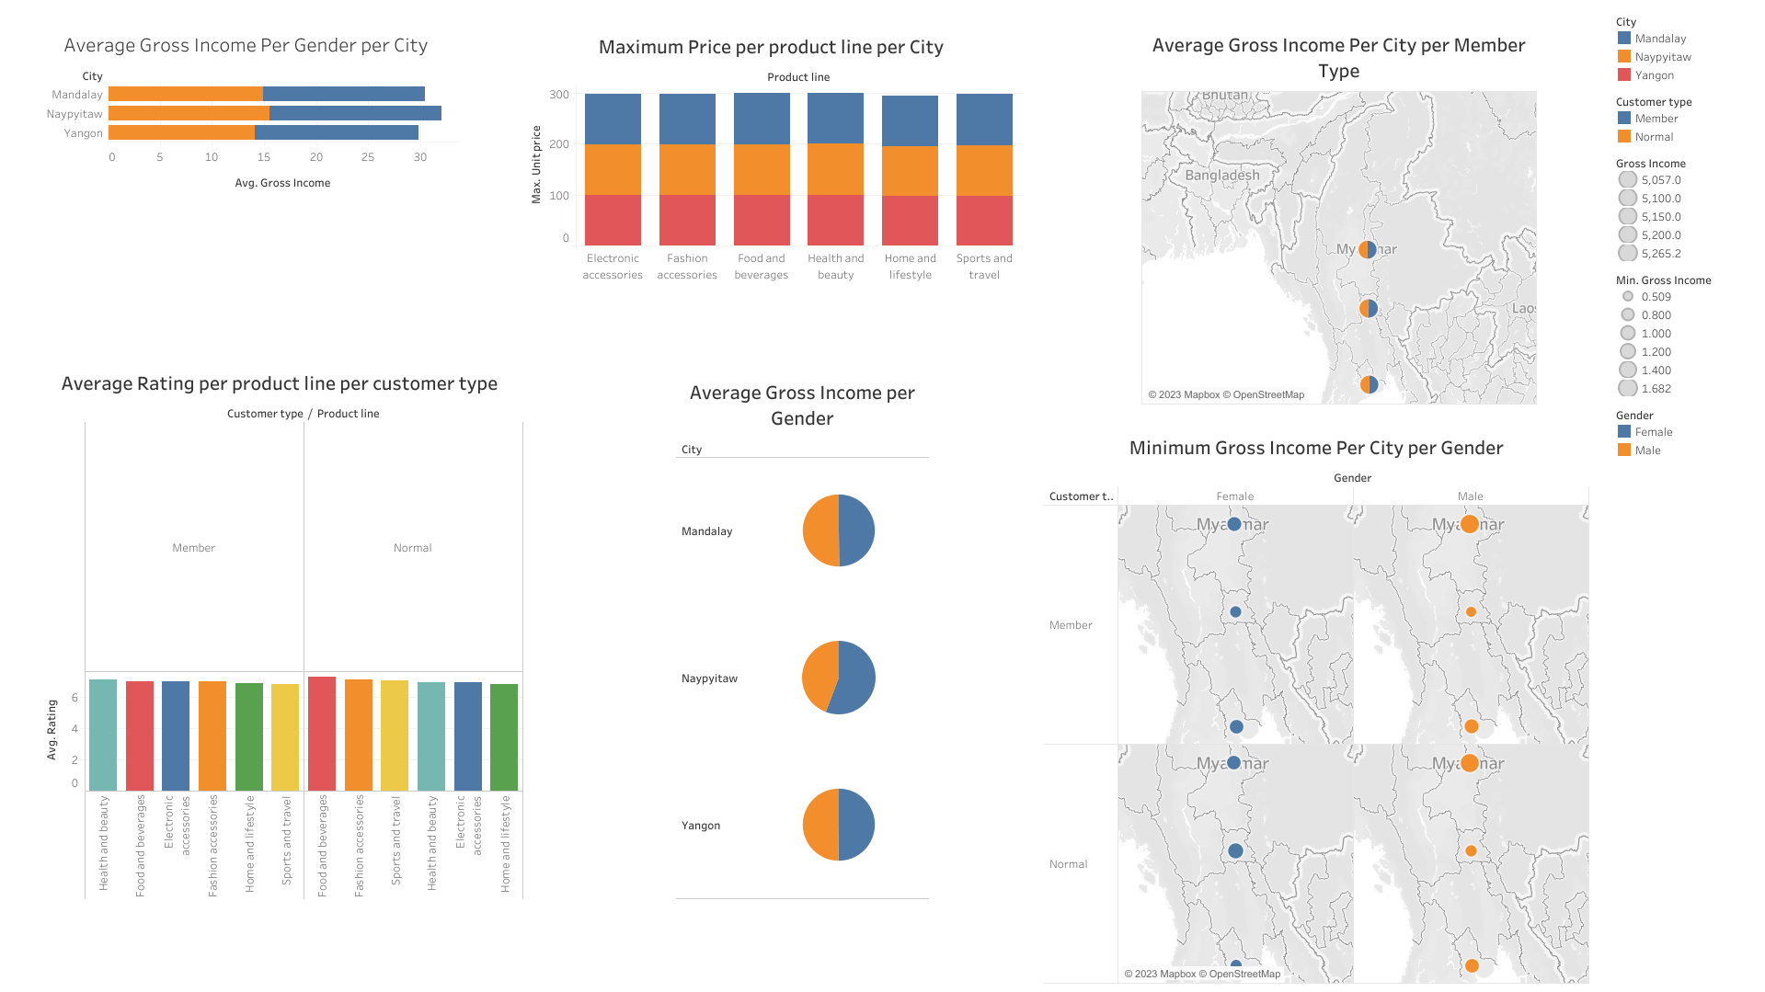

Slide 14
Conclusion:
This analysis concludes that in the representation of gross income of female vs male, the males earn slightly less than the females.
This analysis also proves that the normal customers spend more on food and beverages while the member customers spend more on Beauty and health.
This also proves that the tax% is highest in the city of Naypyitaw, since it is the capital of Myanmar.

Slide 15
Actionable insights and summary
Actionable Insights:
1. Gender Income Disparity:
The analysis highlights a somewhat unexpected result where the representation of gross income for females versus males reveals that males earn slightly less than females. This insight underscores the need to explore the underlying factors contributing to this phenomenon. Initiating research into occupational distributions, wage gaps, and career progression paths could help identify and address gender-based income disparities.

Slide 16
2. Consumer Spending Patterns:
The distinction in spending habits between normal customers and member customers is a valuable insight. Notably, normal customers allocate more of their spending towards food and beverages, while member customers prioritize expenditures on beauty and health-related products and services. Businesses can leverage this information to tailor marketing strategies and offerings to cater to the specific preferences of these two customer segments, potentially increasing customer satisfaction and revenue.
3. Geographic Tax Variation:
The analysis draws attention to the variation in tax percentages across different regions, with the highest tax rate observed in the city of Naypyidaw, Myanmar's capital. This insight has implications for tax policy evaluation and regional economic development strategies. It might be beneficial to investigate the reasons behind the higher tax rate in Naypyitaw, assess its impact on businesses and residents, and consider potential adjustments to ensure equitable tax burdens across the country.

Slide 17
In conclusion, this analysis offers valuable insights into income distribution, consumer behavior, and tax rates. The findings highlight areas of potential concern and opportunity that policymakers, businesses, and researchers can address. By exploring the underlying factors driving these trends, stakeholders can work towards fostering greater economic equality, refining business strategies, and optimizing tax policies for the betterment of society as a whole.

Slide 18
Summary:
The analysis undertaken examines several key aspects of income distribution, consumer spending behavior, and tax rates across different demographics. The findings shed light on interesting trends and patterns that could have implications for various sectors and policies.

Slide 19
THANK YOU

